Slide 1
The Mysterious 15-year NC DEQ Cover-up Missed Opportunities to Stop PFAS Pollution
Tom McKinney
Former DEQ Whistleblower
Sept. 21, 2019

Slide 2
The Devil We Knew…
C8—a perfluorinated polymer used to produce Teflon, stain resistant carpeting and clothing, many applications
Contamination found in water supplies near 3M in WV, production stopped. DuPont Fayetteville STARTS producing in 2002.
C8 found in groundwater by 2003, workers’ blood and off site.
CWFNC joins C8 “Working Group” and investigates w/ Steelworkers’ Union, RiverKeepers
Press conferences, meeting with DENR air, water, waste divisions, DuPont shareholder meetings
Weak EPA “Stewardship Agreement” --new PFAS compounds like GenX in water, 2016

Slide 3
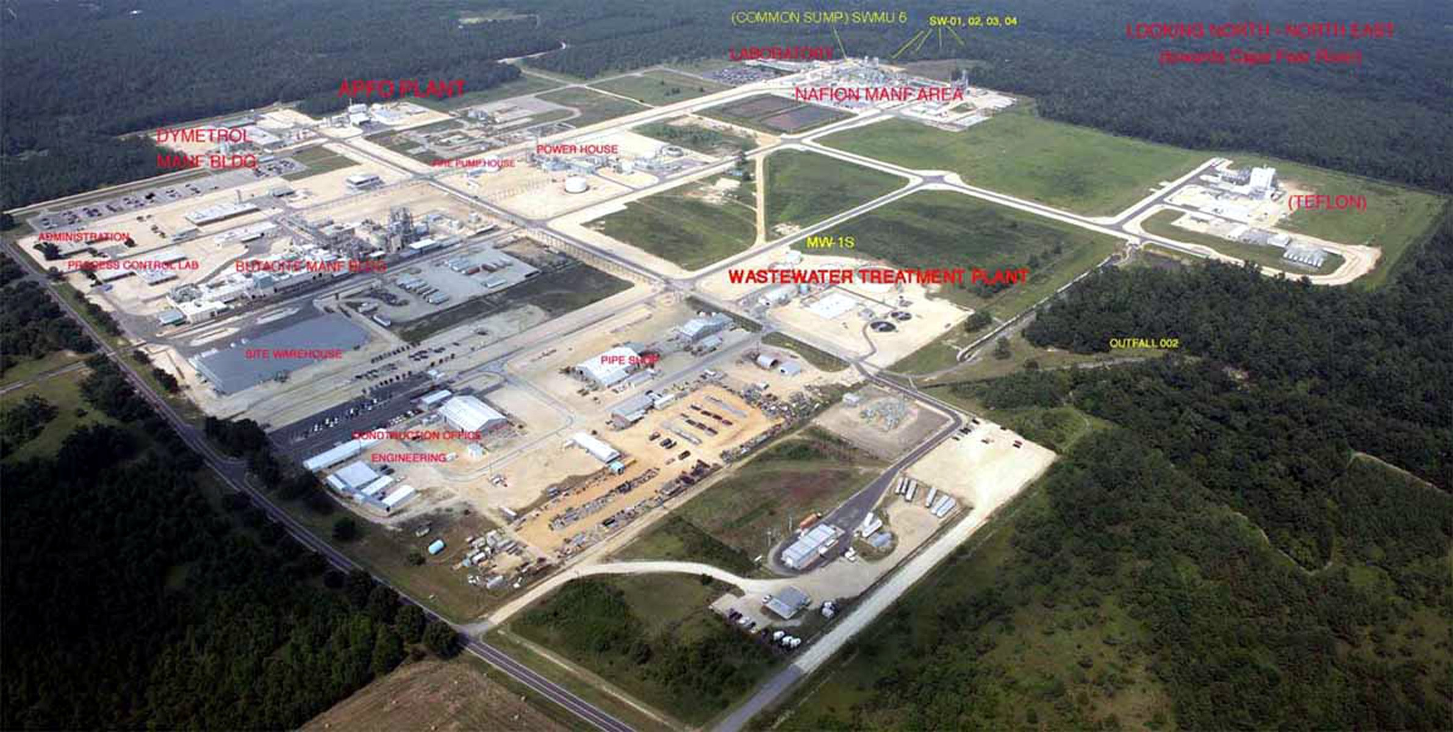

Slide 4
Health Effects of PFAS
Animal Carcinogen
Mammary Tumors
High Cholesterol leading to increased risk of heart attack and stroke
Birth defects
Liver toxicity

Slide 5
Meantime, on the inside….

Slide 8
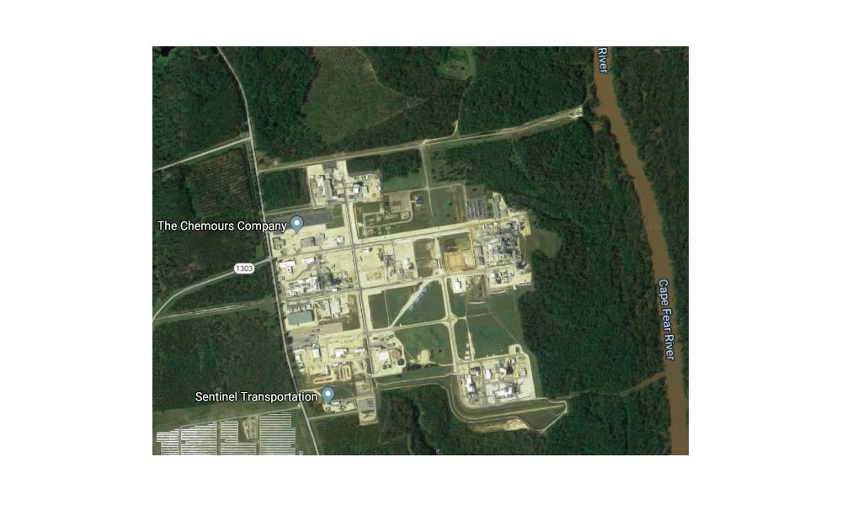

Slide 12
Tom McKinney Email Tomhmckinney@gmail.com Phone (919) 945-4902

